Slide 1


Vocational Development & Employment Services

Slide 2
Introduction
Welcome! Morningside is a non-profit community organization that has supported people with disabilities since 1965. We offer a wide variety of services including:
Employment Planning and Evaluation
Competitive Job Placement
Individual Supported Employment
High School Transition
Vocational Training
Our Staff are committed to providing you quality services to assist you in reaching your vocational goals. Staff meet or exceed the minimum qualifications & receive ongoing training to insure they have the skills and abilities to assist you.

Slide 3
Mission & Vision
OUR MISSION
Morningside advances the employment and self-sufficiency of people with disabilities.
OUR VISION
Morningside envisions a future in which people with disabilities have access to the same opportunities as all other citizens.

Slide 4
Our commitment to you
Our services are a way to help you decide what type of job you want, discover your dreams & interests and help you find the right job in the community. This program is individualized and we need your input and ideas to help us determine how to best work with you and meet your needs.
Whatever your needs, we will work hard to help you. Our goal is to assist you through evaluation, employment planning and other services you might receive.
Please do not hesitate to ask questions if there is something you do not understand or if you want more information about something. We want you to know what is happening every step of the way and to feel comfortable and informed about your program.

Slide 5
Our Commitment (continued)
When you are involved in this program, we will be spending time getting to know each other, exploring our community and where your interest areas fall within our community, discovering what skills sets are present and where skill development may need to occur, we will also begin helping you build a network of family and friends who will assist you in reaching your goal.
The individual employment process is an in-depth process. This process may begin with discovering your dreams and fears and what’s worked for you in the past. Community involvement may be used to discover your interest areas, through work experiences paid and non-paid. Job club, interviewing, resume building and developing a portfolio to share with potential employers will assist you in ultimately reaching employment.

Slide 6
Entrance Criteria
Referrals accepted for services shall meet the following admission criteria:
Third party or private sponsorship
At least 16 years of age
If age 16 through 21, must be released by the Public School System
With support other than Morningside staff, is able to care for personal needs.
Able to benefit from services.
With attendant support and safeguards, displays behaviors that are not dangerous to self or others.

Slide 7
Getting Started – Our first Meeting
A number of meetings will be scheduled before your services begin. Our first meeting is an opportunity for you to meet staff, ask questions, and share information, called ‘Intake’. We are required to obtain certain information from you and you will be requested to complete and sign forms for our records.
You will be working primarily with Morningside staff and any other members on your support team. Your team will include your DVR Counselor or DDA Case Manager and any other significant people in your life that you would like to be involved.

Slide 8
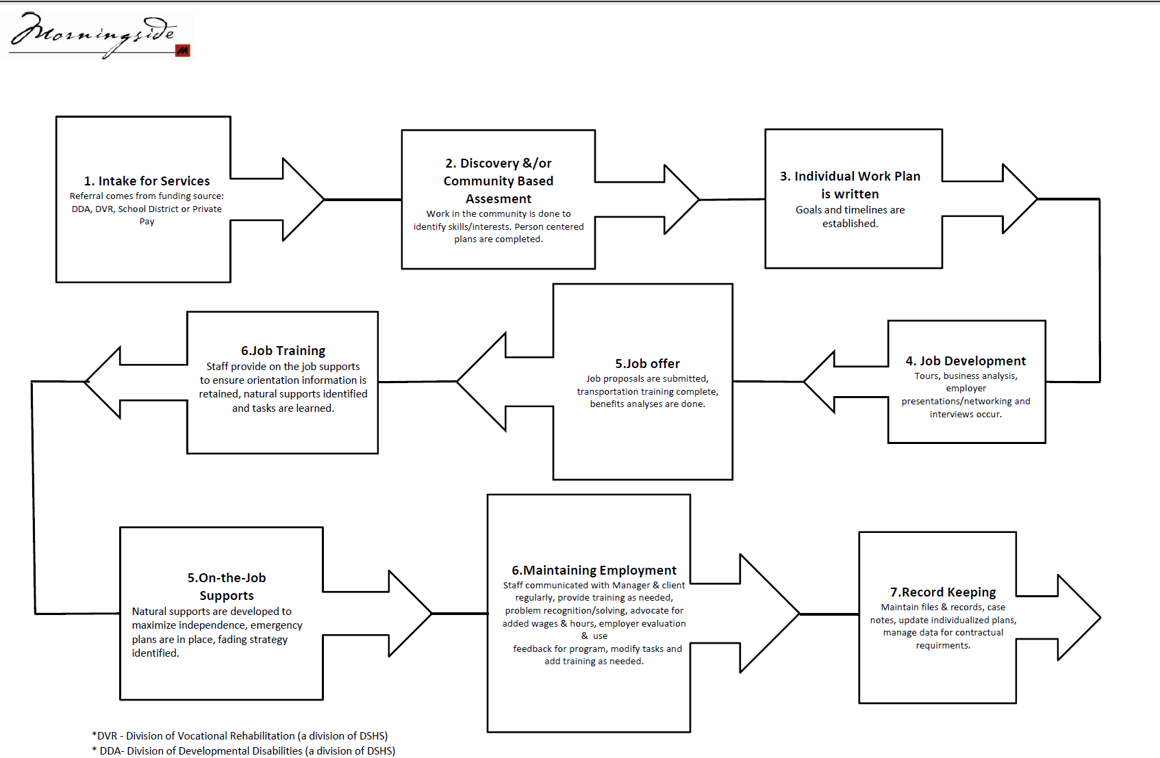

Slide 9
Service Hours
The number of service hours per week you receive will be individualized and be determined by the goals you are working on and may vary as we move through the process of you getting a job.
During your time with this program, you may meet many people from the different agencies and have several meetings. The people at these meetings want to help you find and keep a job that is right for you.
Your involvement is necessary in this process. Remember to ask questions if you or your family do not understand something. We are here to support you and help you.

Slide 10
Discovery
Some individuals may spend time in a discovery phase prior to an Assessment.
In this phase, we will be learning about you and helping you learn about yourself. This may include learning about your dreams, fears, what has and hasn’t worked in the past, exploring current interest areas, developing methods of communication, learning about community involvement and developing a profile and portfolio. This involves teaming up with staff from Morningside to help figure out likes/preferences, marketable skills, communication style and more.
Your DDA case manager will authorize this service. Typically, Discovery will be a first step before completing a Community Based Assessment, depending on your preference and support needs.

Slide 11
Community Based Assessment
Community Based Assessments or CBA’s are similar to work “tryout’s” where individual will develop a plan of different jobs they would like to try out- before committing to actually work for an employer. CBA’s can be similar to “internships” and can be paid- or unpaid.
CBA’s are arranged for through your DVR Counselor (Department of Vocational Rehabilitation) and can last for 30 days to 3 or more months, depending on the particulars.

Slide 12
Planning for a Community Based Assessment
PLAN DEVELOPMENT
Who attends:
Client, Staff, DVR/DDA Representative, Job Developer (for CBA’s), Significant Others
What to expect:
Together we will write your service plan. This includes the type of services you are interested in, information to learn, expected outcomes, etc. You should bring any goals you have for jobs you might be interested in trying out, along with any information such as business contacts, your likes/preferences and dislikes.

Slide 13
Job Development & Placement
After determining what types of environment works best, what skills an individual would like to use, what type of work he/she prefers, your Job Developer at Morningside will help you (along with DVR or DDA Counselor) to find a job in your community.
Job specifics will depend on your interests, likes/preferences, skills and support needs.
One of the best ways for anyone to get a job is to network with families and friends.
You will be asked to share information on whom you know and how they can help in your employment goal.

Slide 14
Job Development (continued)
Job development involves going out and talking to employers about your abilities and interests, working with the business to customize the job to fit your abilities while fulfilling the needs to the business.
A job search can range in time, but you will receive regular communication from your job developer and you will have responsibilities to meet regularly during your job search to fill out applications, produce/update a resume, practice for interviews and attend interviews.

Slide 15
Job Training & Retention
Typically, once an individual has found a job, Morningside can provide training services to help that person learn and maintain the job. These services can range in time period from 90 days to once you feel “stable” at your job to the lifetime of the job.
Services are arranged and paid through by DVR and DDA. Regular meetings will occur between you and your job coach to determine your goals on the job, your progress, any tools or accommodations you may need to succeed and problem solving together as issues arise.

Slide 16
Long term follow along support
Some individuals choose Morningside job coaches to provide long term support to them for the lifetime that they have their job. These services can include: ongoing training for tasks at work, problem solving, weekly/monthly check-in’s, communication support with business/management, etc.
Services are individualized for the client based on preference and need and paid for through DDA or privately, even sometimes through Social Security Work Incentives.

Slide 17
General Rules- Your Commitment
Attendance:
You are expected to attend all meetings as times are arranged with team members. Dependability is an important area employers will be asking about. During your work assessment, you should make every effort to maintain a good attendance record.
Punctuality:
Please arrive on time for all meetings. If you are going to be late for your assessment or an appointment, please call and let someone know. It is also important that you return to work on time following breaks. If you require additional time for breaks due to support needs or medical reasons, please tell your assigned staff person so arrangements can be made.

Slide 18
General Rules- Your Commitment (2)
Absences And Appointments:
Please try to schedule appointments around your work/assessment/meeting schedule whenever possible. If you have a previous appointment that conflicts with your schedule, please let your assigned staff person know as soon as possible. If you are sick, it is your responsibility to tell your supervisor and staff person.
Rules And Dress Code:
All work places have rules and guidelines that need to be followed. Specific rules will vary from one work place to another. Your site will notify you of those rules.
Dress codes will vary from one work place to another. For example, persons at clerical sites are asked to wear clothing appropriate for office work, while janitorial work requires durable clothes and comfortable shoes. You will receive dress code information specific to your assessment site during orientation. If you do not have appropriate clothing, Morningside or DVR may be able to assist you.

Slide 19
General Rules- Your Commitment (3)
Transportation:
All persons are expected to provide and arrange their own transportation. If you need assistance with what bus to take, learning bus routes, where to transfer, etc., please ask and we can help you. Also, if you are a DVR Client, DVR may be able to assist with a bus pass or mileage reimbursement. Please be sure to ask your counselor so arrangements can be made prior to starting your assessment.

Slide 20
Scheduling
Work Schedule And Hours:
You will be receiving a schedule of your work/assessment dates and hours prior to beginning work. It is important that you maintain your hours as scheduled. If you need to make changes, please talk with the staff person working with you and your direct supervisor. For community assessments, you will receive a time sheet to keep track of your hours. It is important that you maintain this record of your participation. The supervisor will be approving the hours at the end of the assessment.

Slide 21
Safety
Before being placed at a community site, you will be informed of any risks prior to accepting a position. Strategies for minimizing the risk will also be developed, if needed.
Safety is everyone’s responsibility. Emergencies such as fire, severe weather, bomb threats, and natural disasters may happen at any time. Become familiar with fire exits and emergency procedures. Please check with your supervisor if you have any questions about safety.
It is important that you immediately report any accident, serious or minor, to your supervisor and your Morningside staff person. You are covered by Morningside’s insurance for any accident that may occur at your work site. If injured on the job, your doctor can file a Labor and Industries claim for you. We have a private insurance company which covers you during an assessment with a community employer.

Slide 22
Other information
Alcohol/Medications
The use of alcohol or non-prescribed drugs is prohibited during work hours. This includes Medical Marijuana.
Referral For Other Services
If you have issues, needs, or concerns that you are not receiving help with, work-related or otherwise, please let us know. We may be able to help or can refer you to another community service agency. A list of Community Resources is provided to assist you.
We want to assist in any way we can if there is anything that may interfere with you getting maximum benefit from our program.

Slide 23
Financial Impact
If you receive Social Security (SSI, SSDI, SSDAC, GAU) it is very important that you notify Social Security or DSHS (for GAU) of any money you earn. Money you earn may impact the amount of money you receive and could impact future benefits.
The Social Security Administration has established rules and regulations to encourage people to work if possible without penalizing you for working. While you may have a reduction in Social Security money while working, you can still earn more each month with wages from employment. Your Social Security representative can work with you to help see how working may affect your benefits & you may contact Plan2Work www.plantowork.org . It is your responsibility to report any wages. Please ask Morningside staff if you need assistance.

Slide 24
Client Rights
The program you are participating in is voluntary.
You should be acting as a team member with Morningside staff and DVR/DDA Counselors. If there is something you do not understand, ask questions. At scheduled meetings and progress reviews, please exchange information about the progress of your program.
Morningside is responsible for upholding the civil rights of all persons receiving services. All clients have the right to be treated with dignity and respect, to be free from discrimination, abuse or harm (including financial or other exploitation, retaliation, humiliation, neglect) the right to privacy and to have their personal information safeguarded, to have services delivered in the least restrictive environment and to have help from an advocate, when preferred.
Morningside is further committed to offering clients’ power and choice in all decisions, assistance participating in workplace/community relationships & activities, recognizing the ability of all to contribute & benefit from employment, promoting full integration and competence.

Slide 25
Client Rights
Rights also include:
The right to informed participation and consent.
The right to refuse or end services at any time.
The right to make choices.
The right to expect all information remains confidential.
The right to review all reports and written documentation from Morningside.
The right to professional services.
The right to an individualized, timely program.
The right to review and participate in planning and program development.
The right to be paid according to the Fair Labor Standards Act.
The right to a healthy and safe work environment.
The right to be treated as an equal regardless of race, color, national origin, disability, sex, religion, creed, age marital status, sexual orientation, veteran status, or any other legally protected status.
The right to remain free from physical, psychological, or sexual abuse.
The right to give written consent before using your name or picture for publicity reasons.

Slide 26
Non Discrimination
The success of your program depends a great deal on you. Responsibilities and program expectations are designed to help you, but you may choose to end services at any time.
Morningside’s mission is to promote the inclusion of people with disabilities into our society. Our vision of society does not include discrimination. We do not discriminate against any person, Client, employee, or vendor because of disability, race, color, religion, creed, gender, national origin, sexual orientation, age, veteran status, marital status, or any other legally protected status.

Slide 27
Non Discrimination
The American’s with Disabilities Act of 1990 (ADA) makes it unlawful to discriminate in the provisions of services or in employment against a qualified individual with a disability. Reasonable accommodations will be made upon request. If you have questions regarding the ADA please ask to meet with the ADA Coordinator.
Morningside also complies with Section 504 of the Reauthorization of the Rehabilitation Act of 1993 and all requirements imposed by or pursuant to the end that, no person shall on the basis of disability, be excluded from participation in, be denied the benefits of, or be otherwise subjected to discrimination under any program, service, or activity it provides.

Slide 28
Confidentiality
Your records are confidential and are available only to those who are involved with you and your program. Confidential information includes:
Any record or report typically filed in your case record.
Payroll and financial information.
Any papers containing information about your status and/or progress.
Any behavior, action, or conversation occurring during any Morningside activity.
Published materials and photographs specific to any individual.
.

Slide 29
Confidentiality (Continued)
You will be asked to sign an “Authorization to Release Information” form to allow us to give information as needed to DSHS (DVR and/or DDA), residential staff, guardians, and other significant others. In order to work with you, we must have a release to share work-related information with your Vocational Counselor or Case Manager if you have one. Beyond that, it is up to you to determine what information needs to be released and to whom. To make sure you are able to benefit from Social Security work incentives, you will be asked to sign a release for the Social Security Administration

Slide 30
Employer Release
If you are going to participate in an assessment with a community employer, we will require a release for prospective employers. This allows us to release specific information to employers regarding your work experience, skills, and any reasonable accommodations needed to perform essential job functions. It is important that our records are kept up-to-date. Please be sure to notify your assigned staff immediately regarding any changes in the following:
Address
Phone
Medications
Income from Social Security or Public Assistance
Emergency contact persons
Guardianship changes
You have the right to review any records we may have unless otherwise restricted.

Slide 31
Complaints
If you have a complaint, we would like to hear from you. The first person you should talk to is your assigned Morningside staff person. We will try to help resolve any concerns or correct any problems you may have. If your complaint cannot be informally resolved in this manner, you may file a grievance using the grievance procedure. Morningside staff is available to help you through the process if needed.
It is our policy to promptly and fairly resolve any problems you may encounter.

Slide 32
Grievance
A grievance may be initiated if you are not satisfied with any or several service-related issues, feel you are being discriminated against, denied rights, receiving unfair treatment, feel policies and procedures are not being followed, or any issues that affect your ability to successfully participate in your program.
This procedure will be reviewed with you when you begin services. Remember, you have the right to be free from retaliation! You will be asked to sign a form confirming that it has been reviewed and explained to you.
If you file a grievance, a parent, family member, guardian, residential support person, referring agency representative or other advocate may if you wish, represent you. If you feel you are in need of or want someone to assist you, please contact your DVR counselor or DDA case manager and he or she will be able to assist you in finding someone.
Following the grievance procedure listed next, is an outline that simplifies the steps showing what to do if you wish to file a grievance. Please talk with staff if you have questions.

Slide 33
How to file a Grievance
Step 1: Contact the appropriate staff person (Employment Consultant or Program Supervisor) to state that a formal grievance is being filed. Outline the facts upon which the grievance is based as you see them and the remedies sought. The appropriate staff person will gather information from all parties and record the facts. The grievance will be forwarded to a Program Manager within 5 working days. If you are located somewhere other than Olympia, please directly contact the VP/COO using 360.943.0512.
Step 2: All documentation regarding the grievance will be submitted to the Vice President. The Vice President shall meet with the individual and the Program Manager or designee within 5 working days. A written decision will be rendered and presented verbally to the client within 5 working days.

Slide 34
How to file a Grievance
Step 3: If you are not satisfied with the Vice President’s decision, all documentation regarding the grievance will be submitted to the President / CEO of Morningside within 5 working days.
Step 4: The President / CEO shall meet with the individual within 10 working days and will render a written decision and present it verbally to the client within 30 working days. The President / CEO is the final appeal step.
If you are not satisfied with the final appeal step, you will be advised of outside agencies you may appeal to such as the Fair Labor Standards Board, Human Rights Commission, Funding Agency, etc.

Slide 35
Grievance Continued
GRIEVANCE PROCEDURE STEPS
Morningside
President/CEO
(360)
596
-
3509

Vice President
Emplyment Services
/COO
(360) 596
-
350
9
-
Ž
Program Manager
or Program Supervisor
Lewis, Clallam, Grays Harbor County (360)239-9340
Thurston County (360) 239-9341 or (360) 742-4858
Pierce County (253)719-3222
?

Assigned Morningside Staff Member
Œ

Slide 36
Exit
Any person may exit services when individual program objectives have been completed; it is determined that the individual is no longer able to benefit from a particular service; or it is the individual’s choice (self-termination).
Morningside’s services are designed to help you with your vocational and employment endeavors. You will be provided with a satisfaction survey following each service. When you leave Morningside, you will be asked to complete an exit interview. We welcome any opinions and suggestions you may have to help us continue providing quality services.
You can visit our website at www.morningsideservices.com to provide feedback via SurveyMonkey or receive a paper version from your Morningside staff person.

Slide 37
Glossary
DVR: Division of Vocational Rehabilitation (a division of Department and Social Health Services)
DDA: Developmental Disabilities Administration (a division of Department and Social Health Services)
Discovery: A process to find out who you are and your ideal conditions for employment
CBA- Community Based Assessment: An opportunity to try different types of work in the community to research your work preferences & aptitudes.
Job coach- Staff who assists you in learning tasks & maintaining employment
Job developer- Staff who assists you in researching businesses, interviewing and obtaining employment.
Long term follow along support: Hours of service that Morningside job coach’s provide to help you meet your goals (e.g. keeping your job, learning new tasks, problem solving).
Release: A form you sign that allows Morningside to talk to individuals you designate
Grievance: An official statement of complaint

